Slide 1
Installation Guide
(Web Server – WebtoB 4.1
- Filter)
2009. 07. 24
CODELABOR
Shin Sang Jae (codelabor@gmail.com)

Slide 2
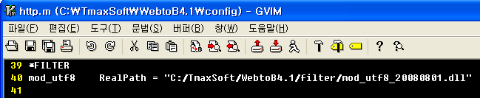
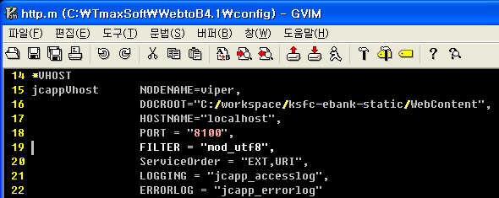
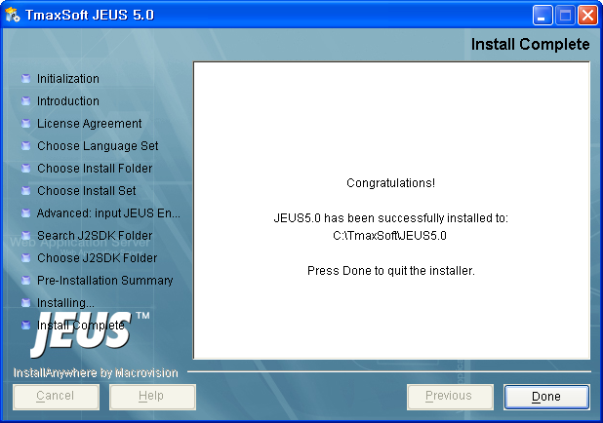
WebtoB
Configuration
Config Directory: C:\TmaxSoft\WebtoB4.1\config
Edit http.m
Add Filter
Add Filter on VHOST

